Slide 1
Visionaries Winter School Presentation
Akshay S Menon
Ishaan Bajaj
Sandra K Joseph

Slide 2
Problem 1 Implementation of path finding algorithms
Task 1.1
Maze with 0.2 to 0.3 probability of black pixels was generated.
Two grey pixels were added to indicate the starting point and destination.
The four algorithms (DFS, BFS, Dijkstra’s and A*) were implemented to find the shortest path between the grey pixels.

Slide 3
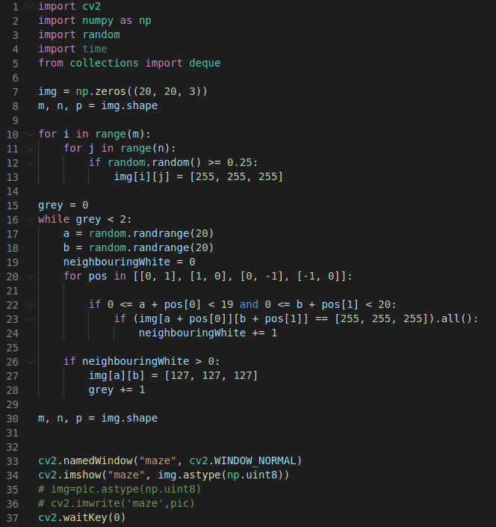
Maze Generation
Setting every pixel as white
The while loop runs until two grey blocks have been placed. A random block is picked and made grey. The nested for loop makes sure that there is at least one white pixel near the spawned grey pixel.

Slide 4

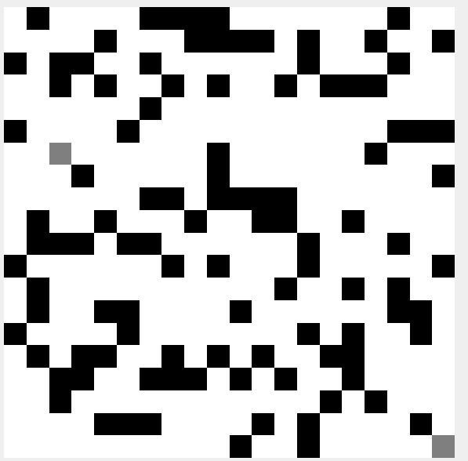
Generated Maze

Slide 5
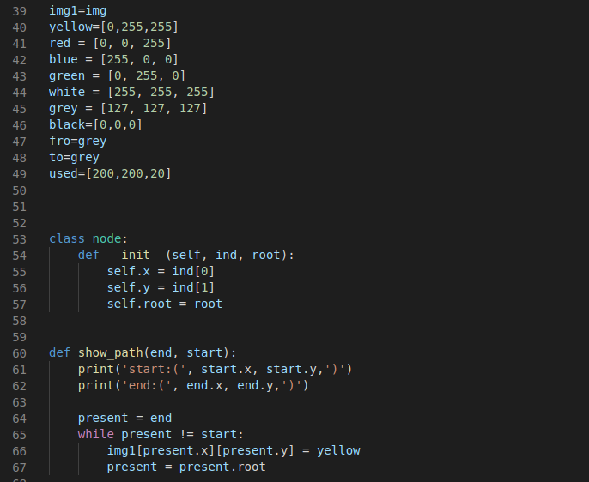
DFS
Assigning values to colors
A class named node is created for storing the link to children
Function to show the final path

Slide 6
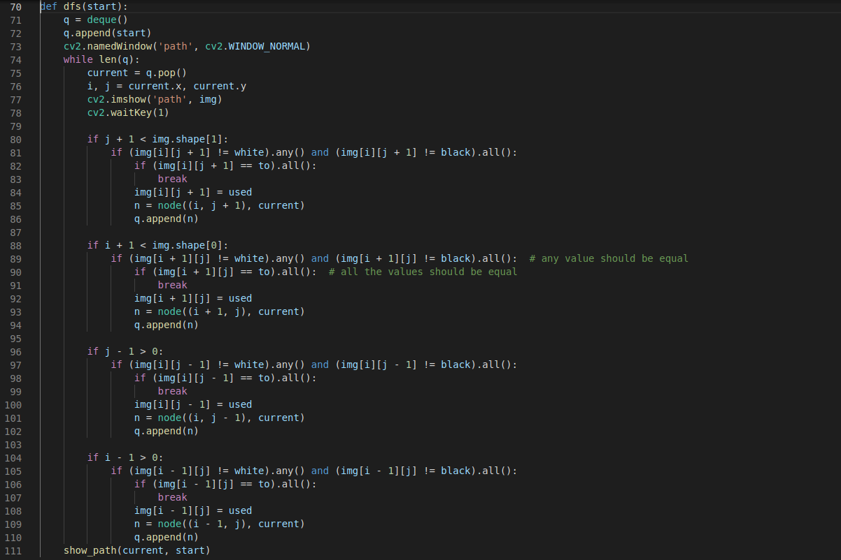
Code for dfs function
Neighbours of the current pixel is checked for existence and then checked for the destination pixel

Slide 7
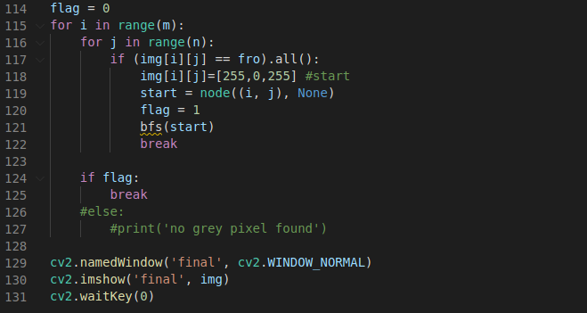
Loop is run on the image to find the starting point

Slide 8
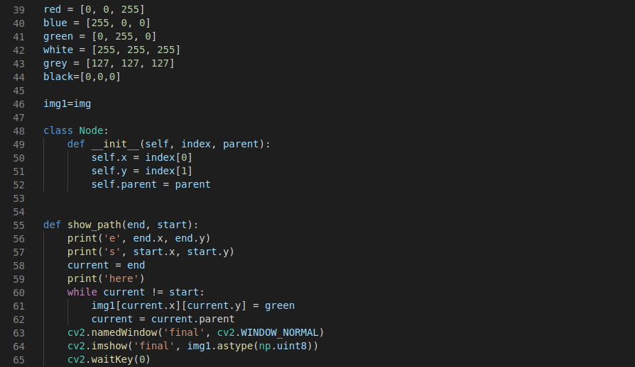
BFS

Slide 9
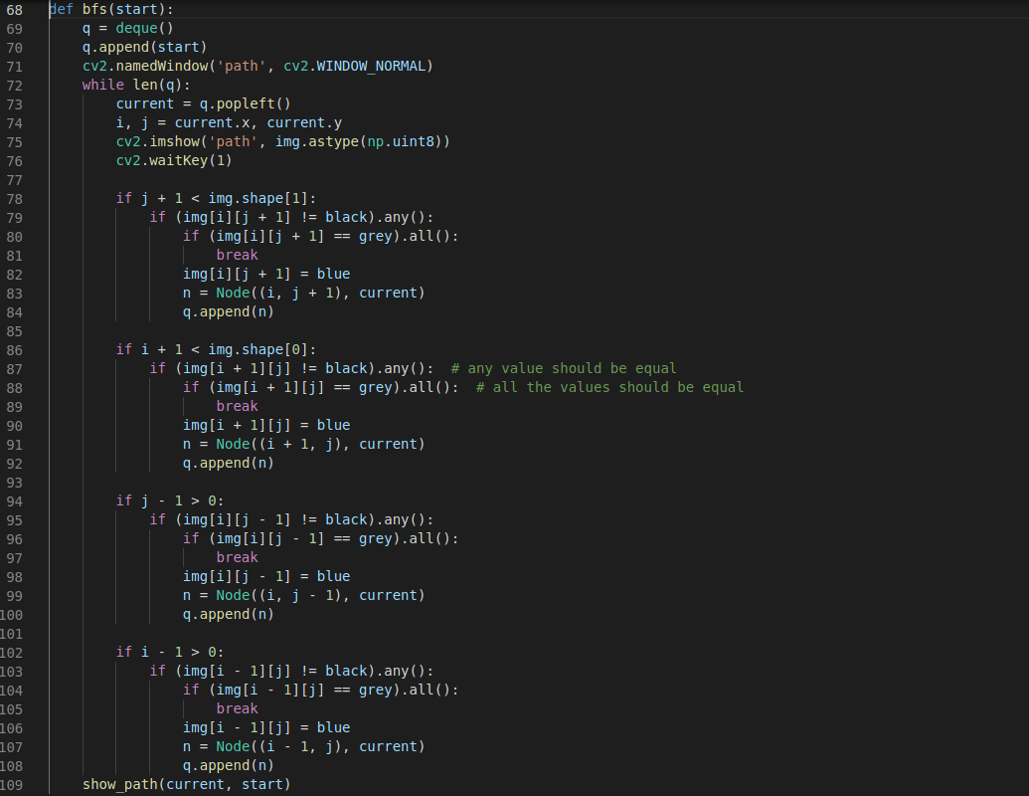
Here elements are popped from the front end of the queue

Slide 10
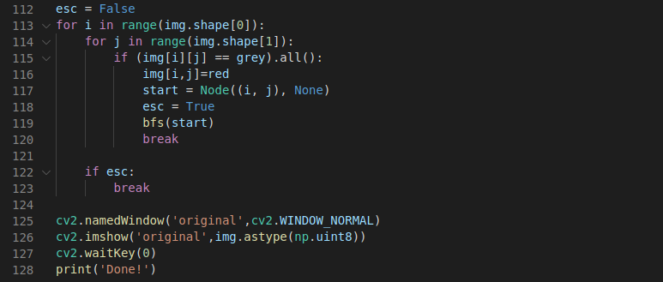

Slide 11
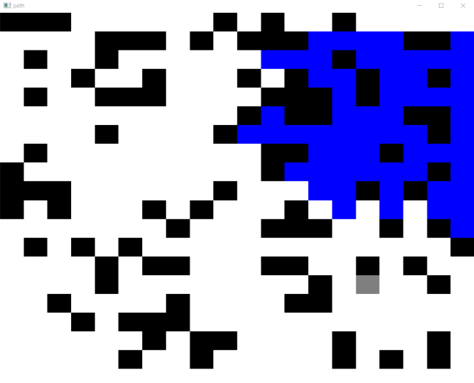
Path finding in BFS

Slide 12
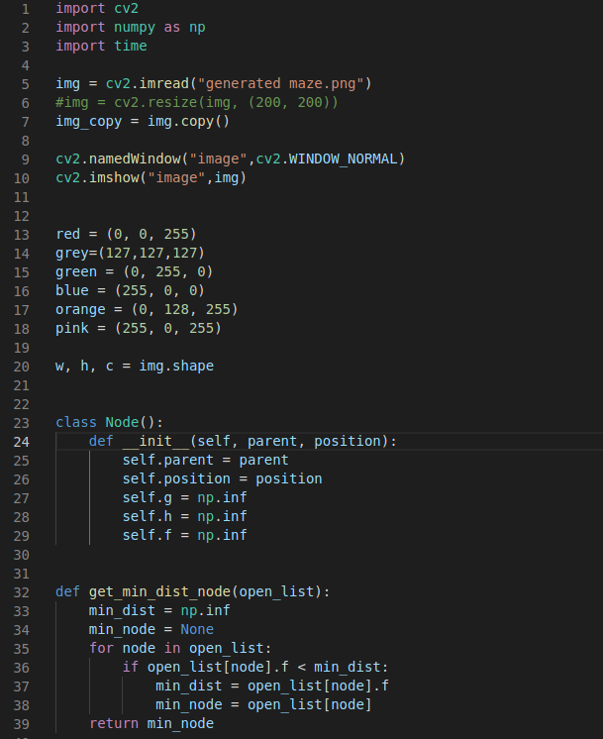
Dijkstra + Astar

Slide 13
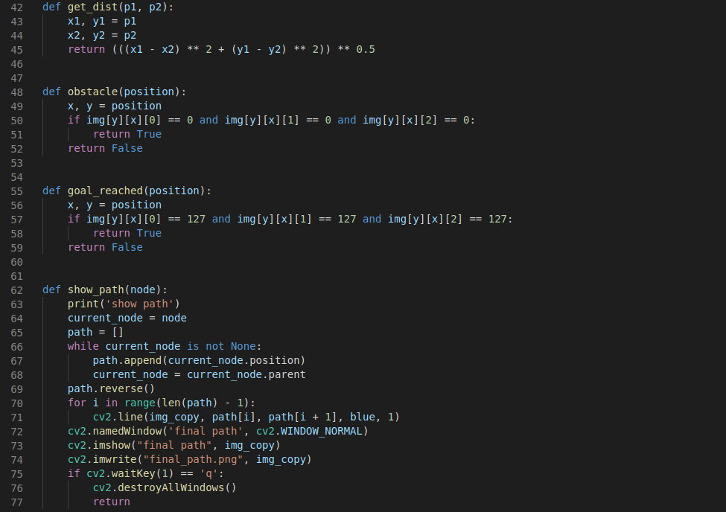

Slide 14
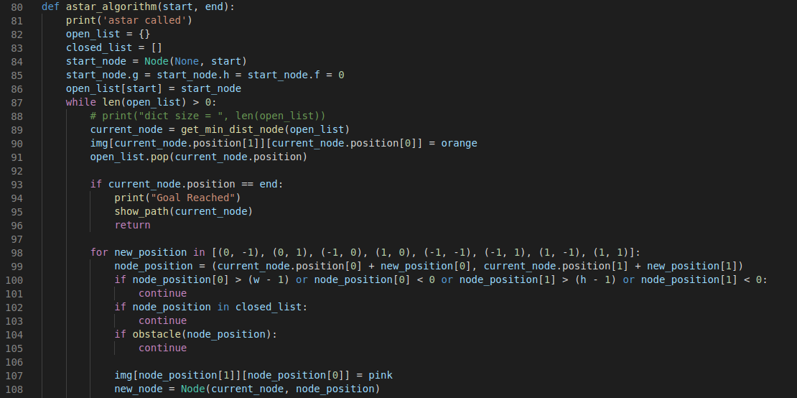

Slide 15
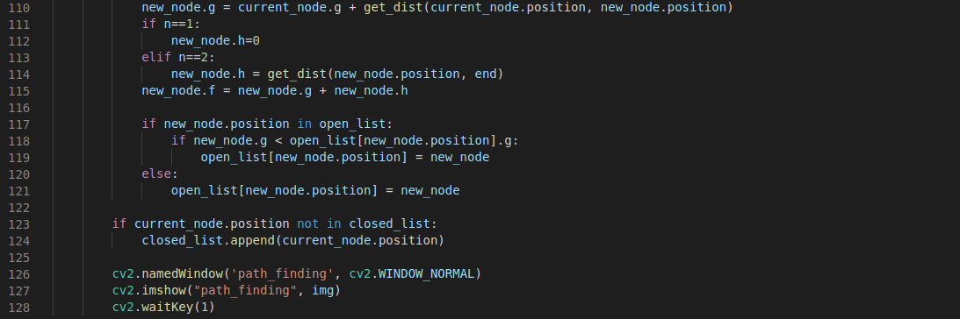

Slide 16
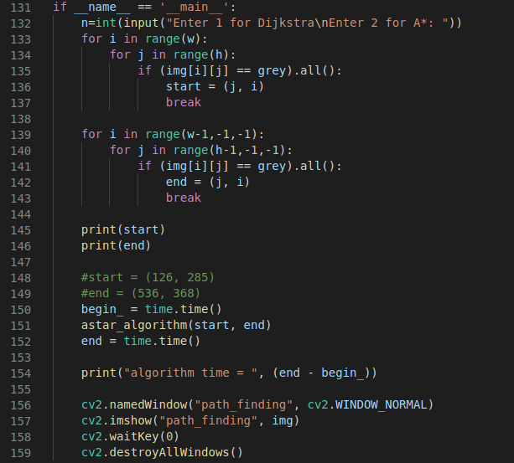
Choice is given to the user whether to use Dijkstra or Astar

Slide 17
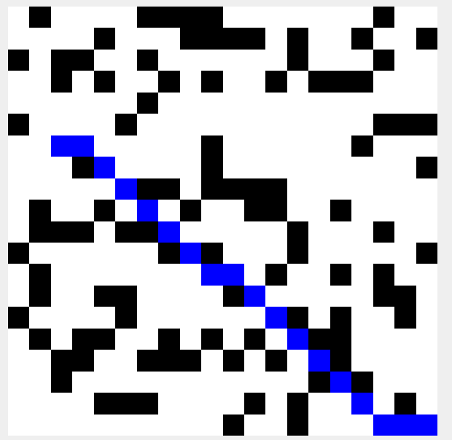
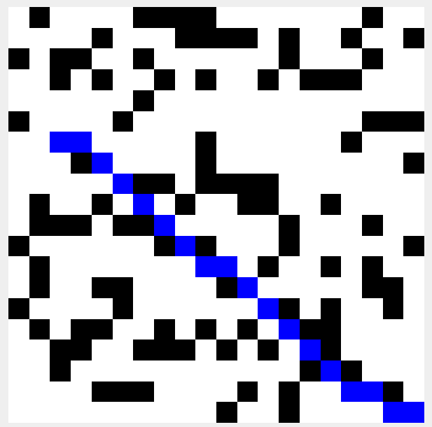
Dijkstra
Astar

Slide 18
Task 1.2 & Task 1.3
All the four codes can be reused in the image provided for path finding by changing the pixels' values

Slide 19
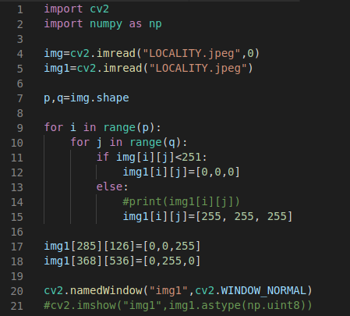
Google maps to binary image conversion

Slide 20
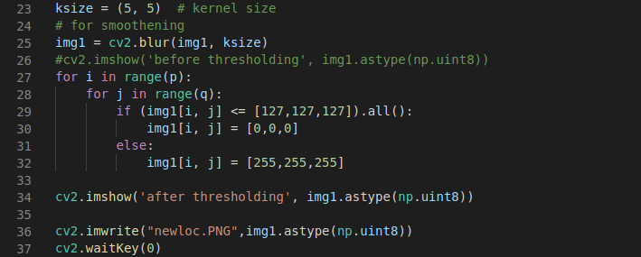

Slide 21
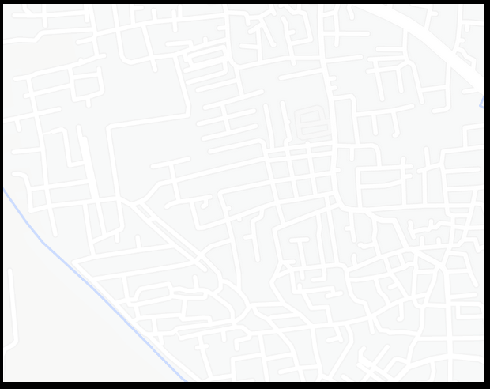
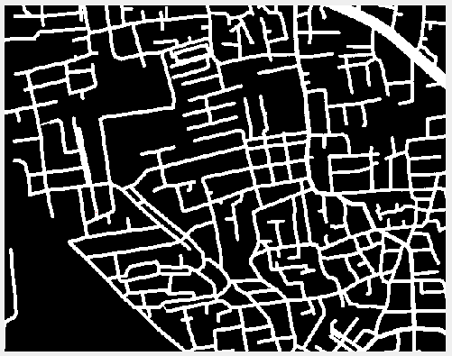

Slide 22

Problem 2 Identification of Road Signs
Task 2.1
A video is made of images of traffic signals.
Templates are cut out of the images used in the video.
Templates are matched with the images in the video to find the signal.
The action that is required to be taken is stored in a text file.

Slide 23
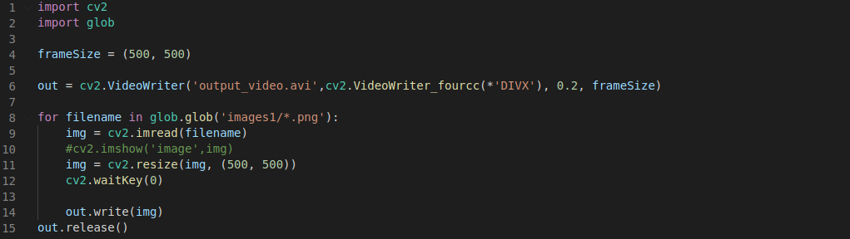
Video Generation
Video is generated from images stored
in a file.

Slide 24
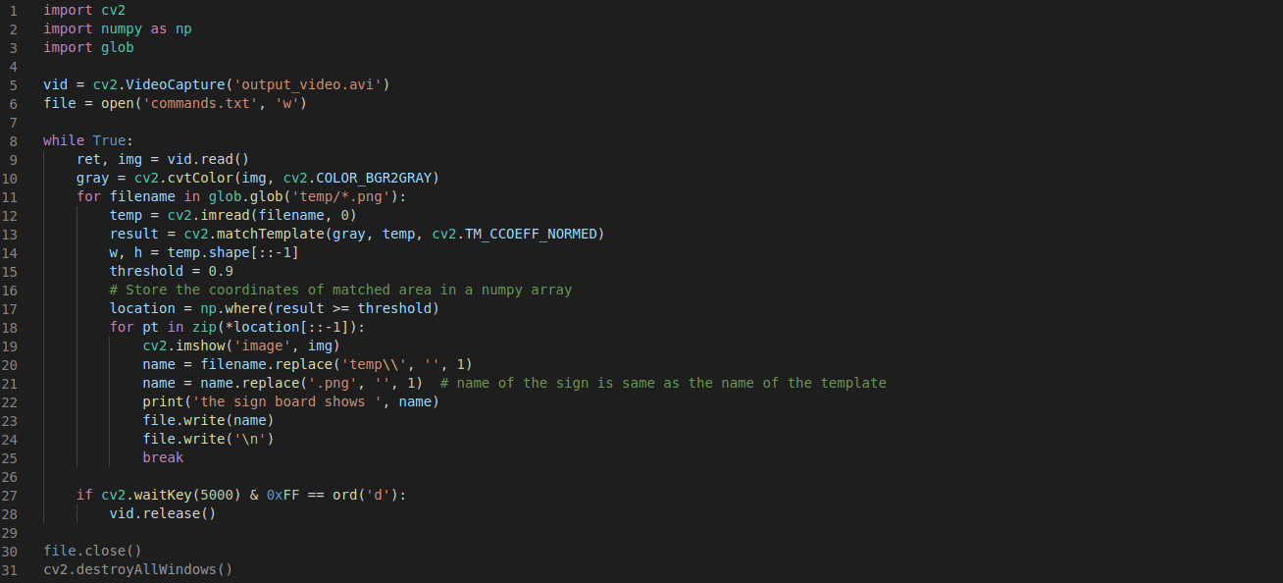
Template Matching
Image is converted to grey scale.
When the template is found to match, the action corresponding to the template is stored in the text file.

Slide 25
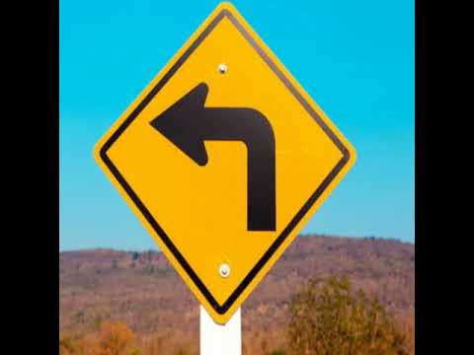
The Generate
Video

Slide 26
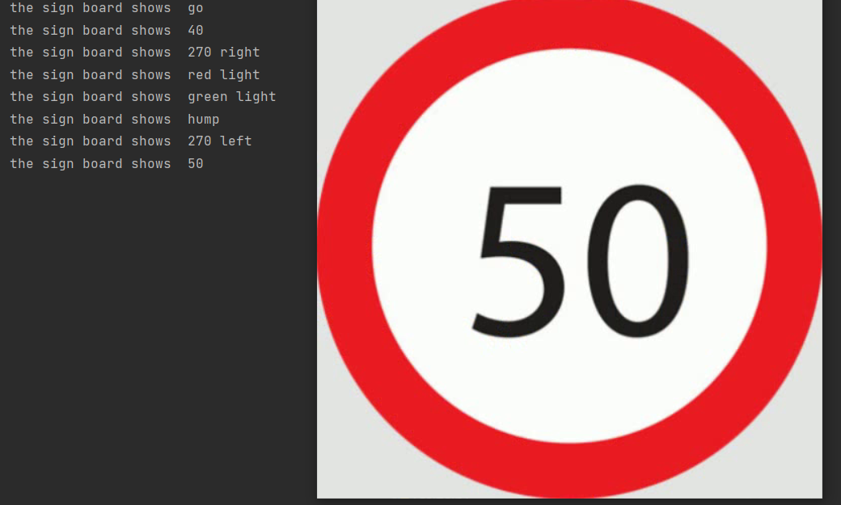
Output

